Slide 1

Ambient Intelligence Project: Ground Regulation at Camp Nou Stadium Based on Grass and Weather Conditions
Ahmet Samet KOSUM, S5635830

Slide 2
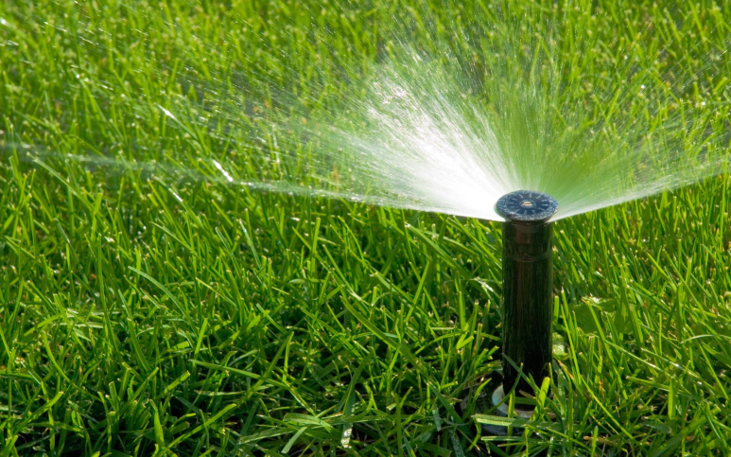
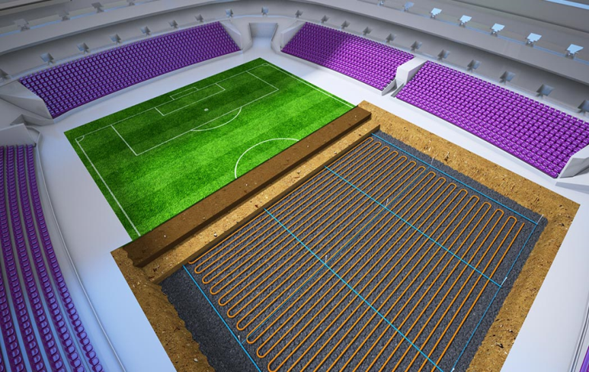

Project ObJectıve
This project introduces an Ambient Intelligence system that optimizes the environment by monitoring grass and weather conditions at Camp Nou Stadium using smart sensors.
In instances of hot weather with dry grass, the Irrigation system will engage to establish and maintain the optimal grass level. Conversely, during cold weather with wet grass, either the Heater system or the Water Grid System will be activated to ensure the grass reaches its optimal condition. Additionally, in extreme cold weather conditions with snow-covered grass, the Heater system will be employed to facilitate the attainment of the optimal grass level. This dynamic system response ensures adaptive and effective measures are taken based on the specific combination of weather and grass conditions.

Slide 3
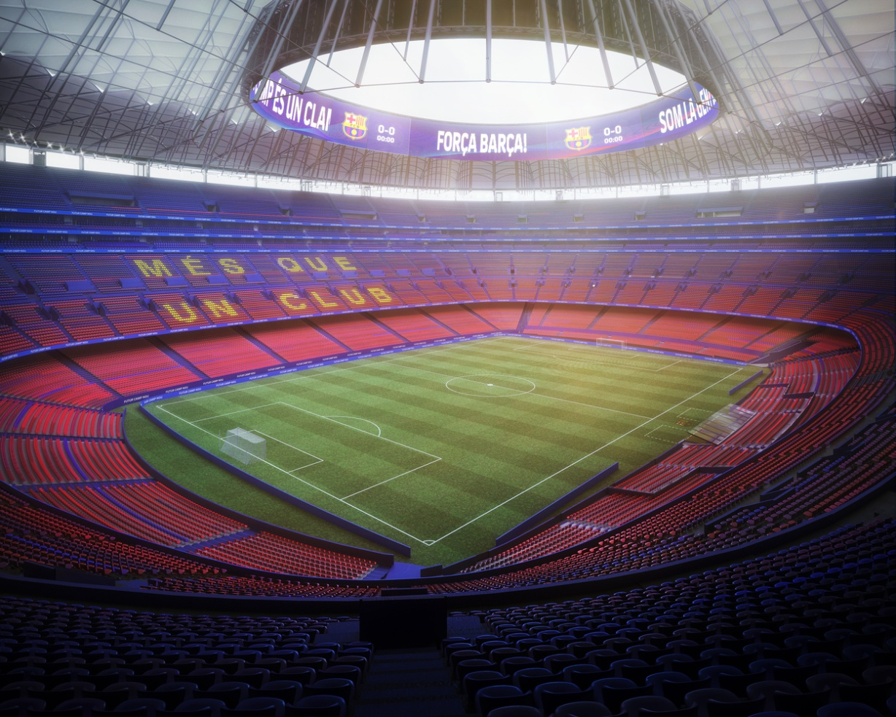
Benefits to Users
1. Comfort and Enjoyable Experience:
Optimized Environment: The project continuously monitors grass and weather conditions, optimizing systems to provide visitors with a more comfortable environment. This enhances the enjoyment of stadium events.
Personalized Control: Users can adjust environmental conditions according to their personal preferences through a mobile application. This allows each visitor to customize their comfort level.
2. Safety and Health:
Optimal Grass Condition: Intelligent interventions ensure the grass is always in optimal condition, crucial for the safety and health of users, especially in a stadium where sports events take place.
Weather Alerts: The system provides alerts about changing weather conditions, allowing visitors to prepare appropriately for outdoor activities.
3. Environmental Sustainability:
Energy Efficiency: By minimizing the energy consumption of Heater, Water Grid, and Irrigation systems, the project supports environmental sustainability.
Optimized Resource Usage: Optimizing resources such as water and energy reduces environmental impact and promotes sustainable stadium operation.

Slide 4

Ambient Intelligence Aspects
1. Real-time Data Processing and Analytics:
Instant Decision-Making: By continuously processing data from smart sensors, the system can adapt to environmental conditions in real-time and make instant decisions.
Predictive Models: Through data analytics and predictive models, the system can forecast future grass and weather conditions, enabling effective interventions.
2. Dynamic System Adaptation:
Adaptation to Variable Conditions: Smart sensors and analytical features allow the system to dynamically adapt to changing grass and weather conditions, ensuring continuous effectiveness.
Smart Adjustments: The system can adapt individually to users, adjusting environmental conditions based on each visitor's preferences.

Slide 5
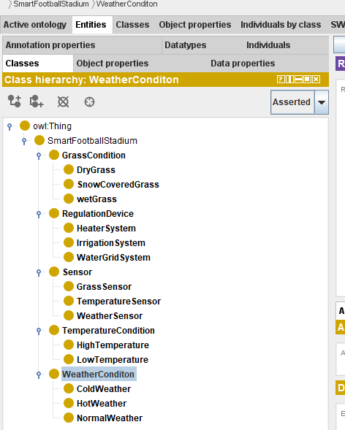
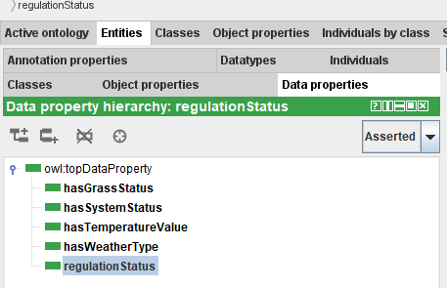
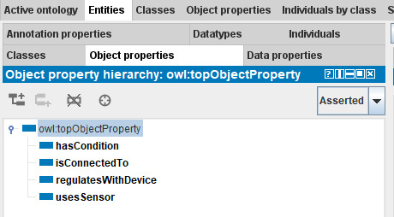
Conclusıon
Our Ambient Intelligence project at Camp Nou Stadium optimizes the environment by dynamically responding to real-time grass and weather conditions. This ensures a personalized and enjoyable experience for visitors, prioritizes safety and health, and promotes environmental sustainability. By leveraging smart sensors and analytics, we've created a cutting-edge system that transforms the stadium experience, making it not only smarter but also more adaptive and eco-friendly.

